Slide 1
HARDWARE & SOFTWARE DESIGN ISSUES
Er. Sahit Baral may 18/2022

Slide 2
2. HARDWARE & SOFTWARE DESIGN ISSUES [10 Hrs.]
2.1 Hardware Design Issues
2.1.1 Combinational And Sequential Logic
2.1.2 Custom Single-purpose Processor Design
2.1.3 Optimizing Custom Single-purpose Processor
2.2 Software Design Issues
2.2.1 Basic Architecture
2.2.2 Operation
2.2.3 Programmer’s View
2.2.4 Development Environment
2.2.5 Application-specific Instruction Set Processor
2.2.6 Selecting A Microprocessor
2.2.7 General Purpose Processor Design

Slide 3
Transistor
A transistor is a basic electrical component in digital system. It acts as a simple ON/OFF switch.
Transistor are abstracted to construct the logic gates in higher level.
One type of transistor is complementary metal oxide (CMOS) which is more popular in combinational circuit design and corresponding technology is called CMOS technology.
CMOS transistor are two types:
1. nMOS Transistor
2. pMOS Transistor
We can apply low or high levels to the gate of the CMOS transistor. We refers logical levels i.e. logic 0 is 0V and logic 1 is 5V

Slide 4
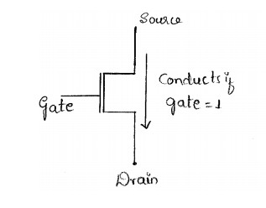
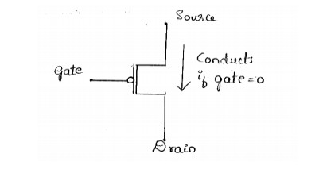
Transistor
The nMOS is conduct when gate is at high voltage(5v)
The pMOS is conduct when gate is at low voltage(0v)

Slide 5
Transistor
cMOS logic circuit is combination of pMOS and nMOS transistor
For logic circuit (.) -> AND, (+) -> OR
(.) operator
pMOS = parallel
nMOS = series
(+) operator
pMOS = series
nMOS = parallel

Slide 6
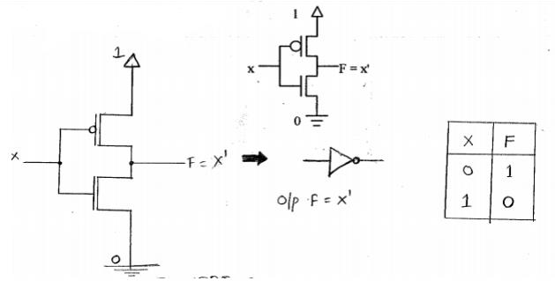
Implementations of Logic gates using CMOS
Invertor(NOT):
When x = 0, transistor T1 conducts but T2 does not.
When x = 1, transistor T2 conducts but T1 does not.
T1
T2
Notes:
Pmos
nmos

Slide 7
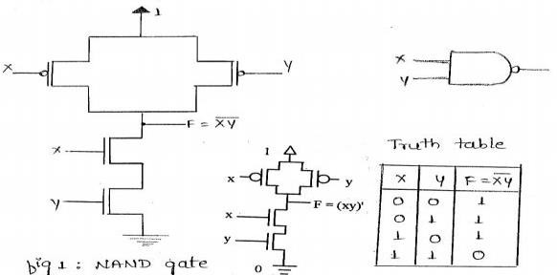
Implementations of Logic gates using CMOS
2. NAND Gate:
When x = 0 and y = 0, T1 and T2 conducts but T3 and T4 don’t. So, F is connected to Vcc.
When x = 1 and y = 0, T2 and T3 conducts but T1 and T3 don’t. So, F is connected to Vcc.
When x = 0 and y = 1, T1 and T4 conducts but T2 and T3 don’t. So, F is connected to Vcc.
When x = 1 and y = 1, T3 and T4 conducts but T1 and T2 don’t. So, F is connected to ground.
T1
T2
T3
T4
Notes:
Pmos
nmos

Slide 8
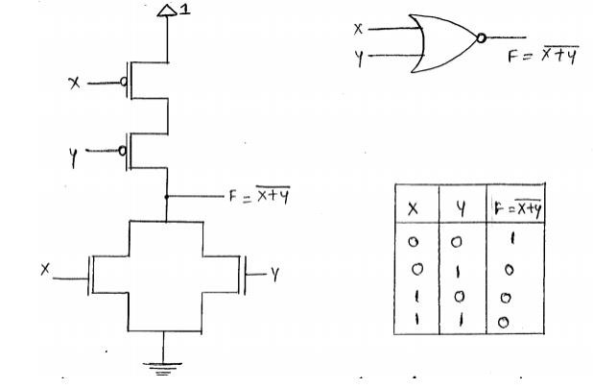
Implementations of Logic gates using CMOS
3. NOR Gate:
When x = 0 and y = 0, T1 and T2 conducts but T3 and T4 don’t. So, F is connected to Vcc.
When x = 0 and y = 1, T2 and T3 conducts but T1 and T3 don’t. So, F is connected to ground.
When x = 1 and y = 0, T1 and T4 conducts but T2 and T3 don’t. So, F is connected to ground.
When x = 1 and y = 1, T3 and T4 conducts but T1 and T2 don’t. So, F is connected to ground.
T1
T2
T3
T4
Notes:
Pmos
nmos

Slide 9
(AB+CD)’

Slide 10
Basic Logic Gates
The NOT(invertor) gate simply complements the input
The AND gate outputs 1 if and only if all of its inputs are 1
The OR gate outputs 1 if at least one of its inputs is 1
The XOR (exclusive-OR) gate outputs 1 when only one of its inputs is 1
The NAND, NOR, XNOR gates outputs the complement of AND, OR and XOR respectively

Slide 11
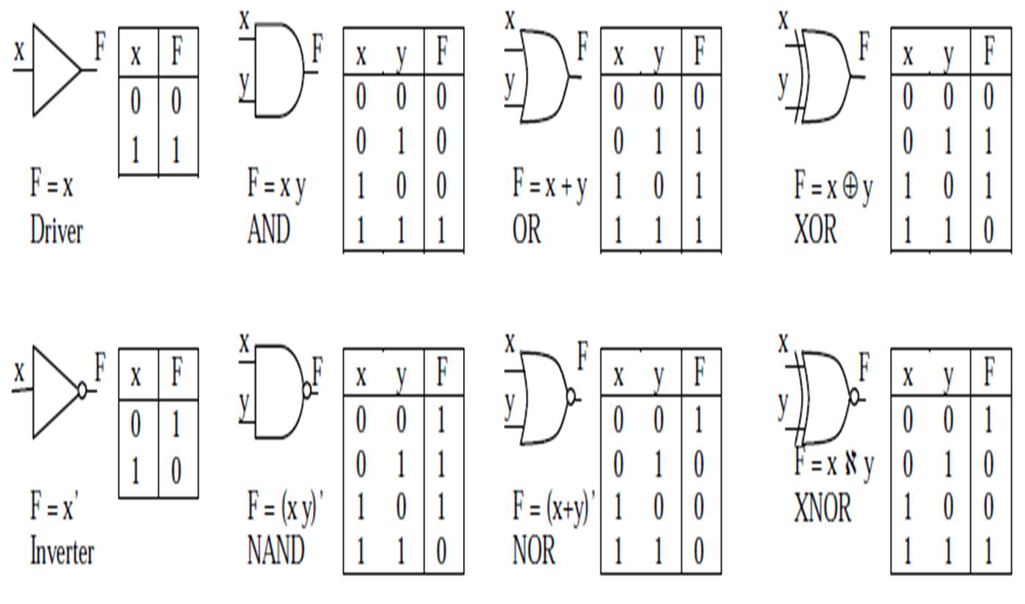
Basic Logic Gates

Slide 12
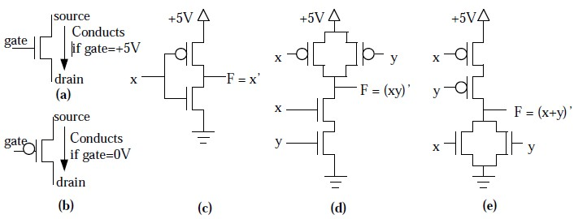
CMOS transistor implementations of some basic logic gates
(a) nMOS , (b) pMOS transistor, (c) inverter, (d) NAND gate, (e) NOR gate

Slide 13


Combinational Logic Design
A combinational circuit is a digital circuit whose output is purely a function of its current inputs; such a circuit has no memory of past inputs
Use basic logic gates to design combinational circuit
Combinational logic ckt
input
output

Slide 14
General steps for combinational logic design
The description is translated into a truth table with all possible combinations of inputs values
The input values lies on the left of the truth table and the corresponding output values of the inputs lies on the right of the truth table
For each output, we have to derive the equations. The equation may contain number of combinations of the inputs. The number of combinations depends on the number of high(1) value on each column of the output. Rows of the inputs are used to derive the equation corresponding to the high output of the column. And the equation must be further minimized
Another way to derive minimized equation directly id by using k-map. It is always better to use k-map unless the design is too simple(when the output column consist of only one high value)
The final equation is translated into an equivalent circuit diagram using logic gates

Slide 15
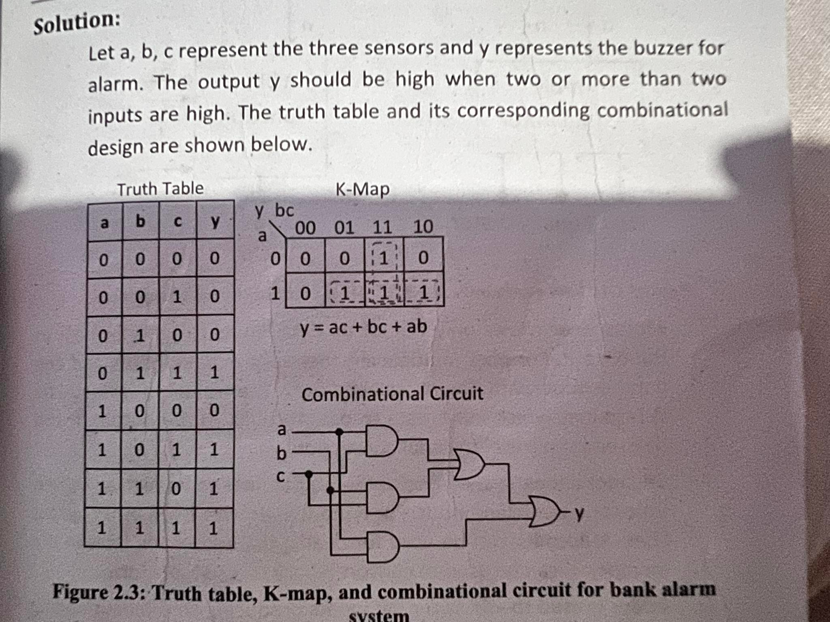
Combinational logic design example:
Q. In an alarm system of a bank, three sensor are implemented and the alarm is triggered when at least two sensor detect the change. Assuming sensors to output digital values, design a combinational circuit for alarm system.

Slide 16
RT-Level Combinational Components
Register - transfer or RT level components are generally used when the design of the circuit becomes complex.
As the number of input increase, the complexities of the design increases
One of the ways to reduce design complexities is by using RT-level components
Some of the component are:
Multiplexer
Decoder
Adder
Comparator
Arithmetic-Logic unit
Shifter

Slide 17
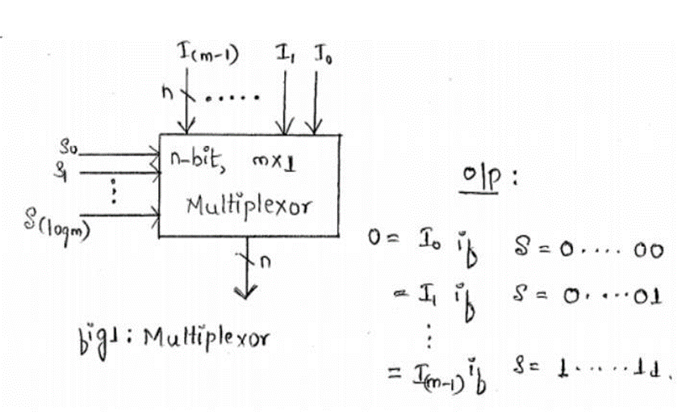

RT-Level Combinational Components
Multiplexer:
It allows only one of its data inputs to pass through to output
For m*1 multiplexer, there are m data inputs and one data output with $\log_{2}m$ select lines
The value of select line determines which input data to pass through to the output
It can be used as parallel to serial transmission

Slide 18
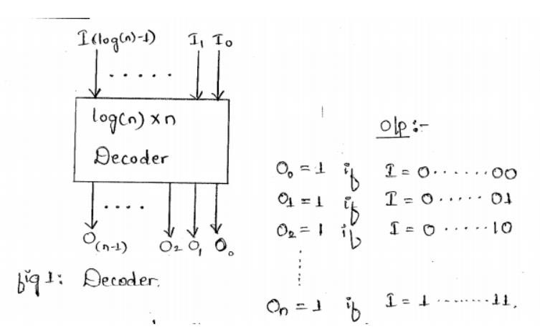
RT-Level Combinational Components
Decoder:
It allows exactly one of the output lines to be high at a given time for particular input
For n input lines, there will be 2^n output lines
A decoder can be used for coding the addressing lines in the memory
It can be used to convert binary to suitable form

Slide 19
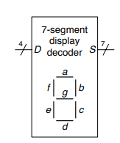

RT-Level Combinational Components
Decoder:
Q1.
A seven-segment display decoder takes a 4-bit data input D3:0 and produces seven outputs to control light-emitting diodes to display a digit from 0 to 9 and also A to F. Write a truth table for the outputs, and use K-maps to find Boolean equations for outputs. Assume that illegal input values (10–15) produce a blank readout.

Slide 20
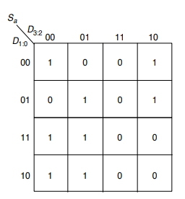
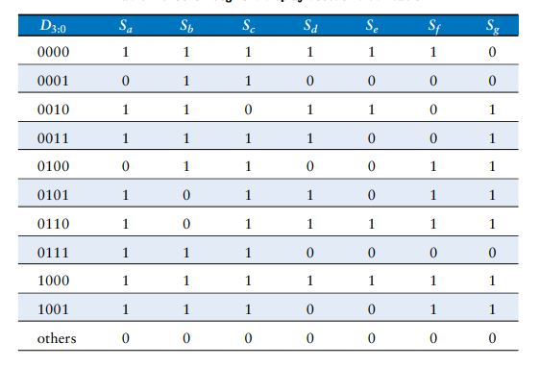
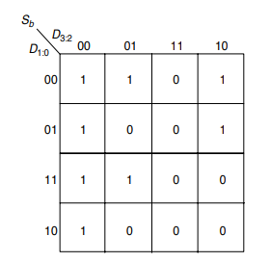
RT-Level Combinational Components
Decoder:

Slide 21
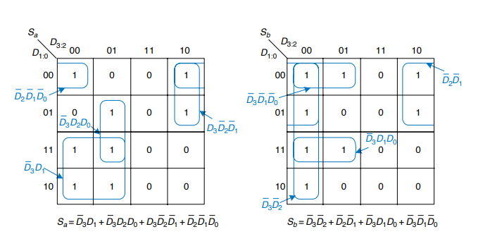
RT-Level Combinational Components
Decoder:

Slide 22
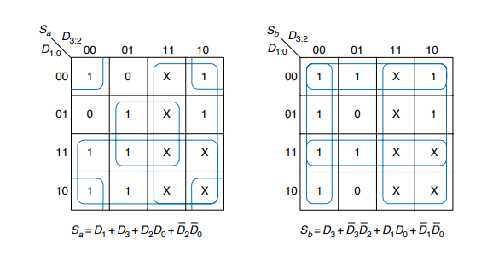
RT-Level Combinational Components
Decoder: with don’t care

Slide 23
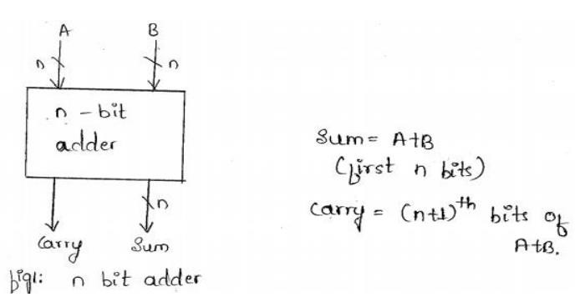
RT-Level Combinational Components
Adder:
It is used to add two n-bit bits producing an n-bit sum along with a carry of 1 bit

Slide 24
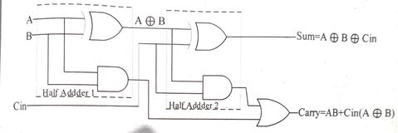

RT-Level Combinational Components
Adder:
Inputs |  |  | Outputs
A | B | ^{C}in | ^{C}out | S
0 | 0 | 0 | 0 | 0
0 | 0 | 1 | 0 | 1
0 | 1 | 0 | 0 | 1
0 | 1 | 1 | 1 | 0
1 | 0 | 0 | 0 | 1
1 | 0 | 1 | 1 | 0
1 | 1 | 0 | 1 | 0
1 | 1 | 1 | 1 | 1
Inputs |  | Outputs
A | B | C | S
0 | 0 | 0 | 0
1 | 0 | 0 | 1
0 | 1 | 0 | 1
1 | 1 | 1 | 0

Slide 25
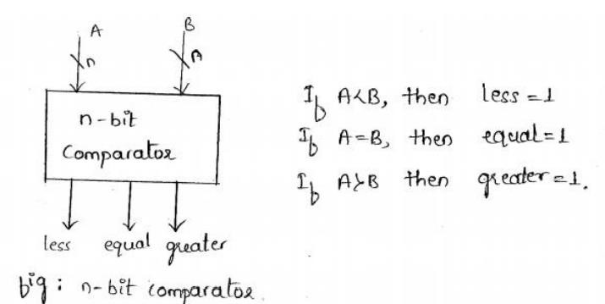
RT-Level Combinational Components
Comparator:
An n-bit comparator compares n –bit data say A and Band generates the output as
A<B or A=B or A>B

Slide 26
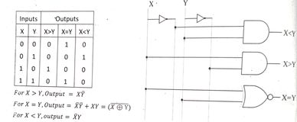
RT-Level Combinational Components
Comparator:

Slide 27
RT-Level Combinational Components
Shifter:
An n-bit shifter can shift the n bit data stored on n-bit register towards right or left direction.
Arithmetic Logic Unit
It performs variety of arithmetic and logic functions on its n-bit inputs
The select line is used to select which function is to be carried out.
If there are 2^m functions that can be done by ALU then there must be at least m select lines

Slide 28
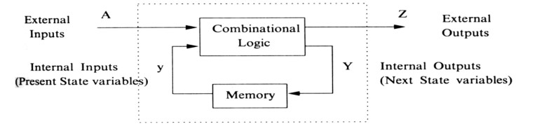
Sequential Logic Design
Sequential logic circuits are those whose outputs are also dependent upon past inputs, and hence outputs.
In other words the output of a sequential circuit may depend upon its previous outputs and so in effect has some form of "memory".
The mathematical model of a sequential circuit is usually referred to as a sequential machine.
Sequential circuits are basically combinational circuits with the additional properties of storage (to remember past inputs) and feedback.

Slide 29

Sequential Logic Design
The values stored in memory elements define the state of a sequential component.
Since memory is finite, therefore, the sequence size must always be finite, which means that the sequential logic can contain only a finite number of states.
So sequential circuits are sometimes called finite-state machines. Sequential circuits can be a asynchronous or synchronous.
Asynchronous sequential circuits change their state and output values whenever a change in input values occurs.
Synchronous sequential circuits change their states and output values at fixed points of time, which are specified by the rising or falling edge of a free-running clock signal.

Slide 30
Sequential Logic Design
Flipflop
A flip-flop is a sequential circuit which is popularity known as a basic digital memory circuit.
It stores 1 bit, therefore it is called as 1-bit memory cell
It has two stable states: logic 1 and logic 0 i.e. two outputs, one normal (Q) and another inverted complement(Q’).
It can flip from one states to another and then flip back, so it is called flip-flop and also known as a bitable multivibrator, latch or toggle

Slide 31
Sequential Logic Design
Flipflop
The outputs Q and Q’ are always complementary to each other
If Q = 0, Q’ = 1 and vice versa; Q=Q’=0 or 1 is invalid
If Q = 1, Q’=0 -> set and If Q = 0, Q’=1 -> reset
Types:
Basic flipflop
SR flipflop
D flipflop
JK flipflop
T flipflop

Slide 32
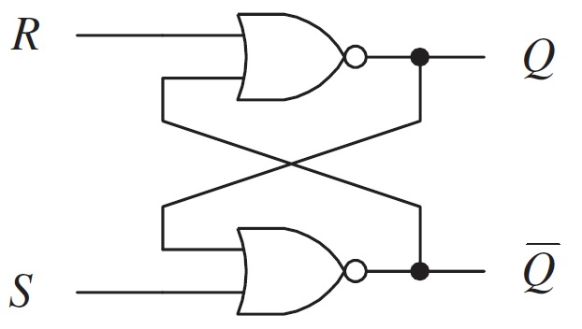
Sequential Logic Design
Basic flipflop circuit
The basic flip-flop has two inputs SET(S) and RESET(R) and two outputs Q and Q’.
It can be implemented using NOR and NAND gates

Slide 33
Sequential Logic Design
Basic flipflop circuit
Case :1 S = 0 , R = 1, Q = 0 & Q’ = 1 S = 0 , R = 0, Q = 0 & Q’ = 1
Case :2 S = 1 , R = 0, Q = 1 & Q’ = 0 S = 0 , R = 0, Q = 1 & Q’ = 0
Case :1 S = 1 , R = 1, Q = 0 & Q’ = 0 S = 0 , R = 0, Q = 0 & Q’ = 1 S = 0 , R = 0, Q = 1 & Q’ = 0
S | R | Q | Q’
0 | 0 | Memory(same as before)
0 | 1 | 0 | 1
1 | 0 | 1 | 0
1 | 1 | Not used
Set
reset

Slide 34
Sequential Logic Design
Basic flipflop circuit using NOR gates
S | R | Q | Q’
0 | 0 | Not used
0 | 1 | 1 | 0
1 | 0 | 0 | 1
1 | 1 | Memory(same as before)
Set
Reset

Slide 35
Sequential Logic Design
From notes

Slide 36
SINGLE PURPOSE PROCESSOR
A single purpose processor is a digital circuit designed to execute exactly one program.
A basis processor consists of controller and data path.
The datapath stores and manipulate system’s data.
Controller caries out such configuration of the data path.
The datapath contain register units, functional units and connection like wires and multiplexer

Slide 37
Data Path
Stores and manipulates a systems data of different forms
Data may be binary numbers that represent temp, speed, pressure, character's or images
Contains registers units, functional units and connection like wires and multiplexers.
The data path can be configured to read data from particular registers, feed that data through functional units configured to carry out particular operations like add or shift and store the operation results back in to the particular registers.

Slide 38
Controller
Controller caries out such configuration of the data path.
It sets the data path control inputs, like register load and multiplexer select signals, of the registers units, functional units and connection units to obtain the desired configuration at a particular time.
It monitors external control inputs as well as data path control outputs known as status signals, coming from functional units, and it sets external control outputs as well.

Slide 39
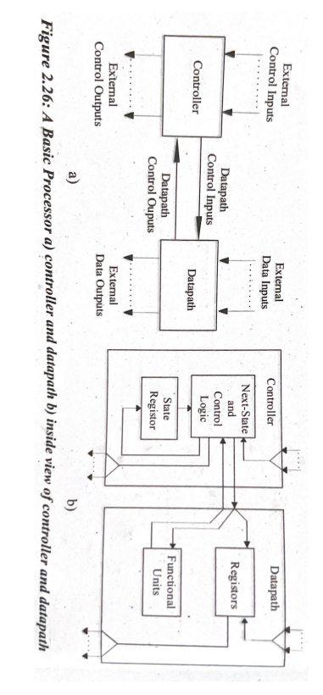
Datapath & Controller

Slide 40
Custom Single Propose Processor
Features
Contains only the components needed to execute a single program
No program memory
Benefits
Performance may be faster, due to fewer clock cycles resulting from a customized data path and due to shorter clock cycles resulting from the simpler controller logic.
Size may be smaller due to simplest data path and no program memory.
Power consumption may be less due to more efficient computation.

Slide 41
Converting a program to an FSMD
Statements:
Statements are used to implement the logical operation, data flow and control flow during the custom single processor design.
Some of the useful statements are:
1. Assignment statements
2. Loop statements
3. Branch statements

Slide 42

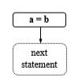
Converting a program to an FSMD
Assignment statements
Assignment statements are used to initialize the fixed data into a variable or transfer of data from one variable to another.
For example a =5, b = 10, d = a etc. It is used to create a single state and available for next statement.

Slide 43
Converting a program to an FSMD
Loop statements
The control statement are represented by the loop statements.
For loop statement: -
We create condition statement C and a join state J, both have no action.
We add an arc with the loop’s condition state to in first statement in loop body.
We create the second arc with the complement of the loop’s condition from the condition state to next statement after the loop body.

Slide 44
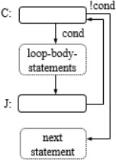

Converting a program to an FSMD
Loop statements

Slide 45
Converting a program to an FSMD
Branch statements
Branch statements are used to alter the execution order of statements with or without condition.
For branch statements: - We create the condition statement C with a join statements J both with no action.
We create the arc from the first branch statement from the condition statement.
We add another arc with the complement of first branch condition ANDed with second branch condition from the first statement of first branching condition. We repeat this for all branching conditions.
Finally we connect the arc leaving the last statement of each branch to join state and we add an arc from this state to next statement state.

Slide 46
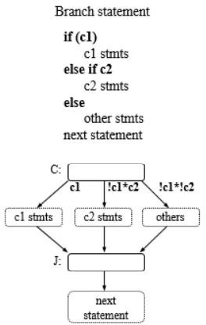
Converting a program to an FSMD
Branch statements

Slide 47
Steps to Design Single Custom Processor
Steps:
1. Draw a black box that shows the abstract view of the implementation logic.
2. Derive the algorithms to implement the functionality of system.
3. Derive the state diagram to implement the operational logic in terms of control flow, dataflow and applicable logic using different statements.
4. Design the data path, functional unit as well as controller to implement the complex logic specified in step 2.

Slide 48
Steps to Design Single Custom Processor
The data path can be designed as below:
• Create a register for any declared variable
• Create a functional unit for each arithmetic operation
• Connect the ports, registers and functional units
– Based on reads and writes
– Use multiplexors for multiple sources
• Create unique identifier
– for each datapath component control input and output

Slide 49
Steps to Design Single Custom Processor

Slide 50
Optimizing custom single purpose Processors
Optimization is the task of making design metrics values the best possible.
Optimizing the original program
Optimizing the FSMD(finite state machine with data)
Optimizing the data path
Optimizing the FSM(finite state machine)

Slide 51
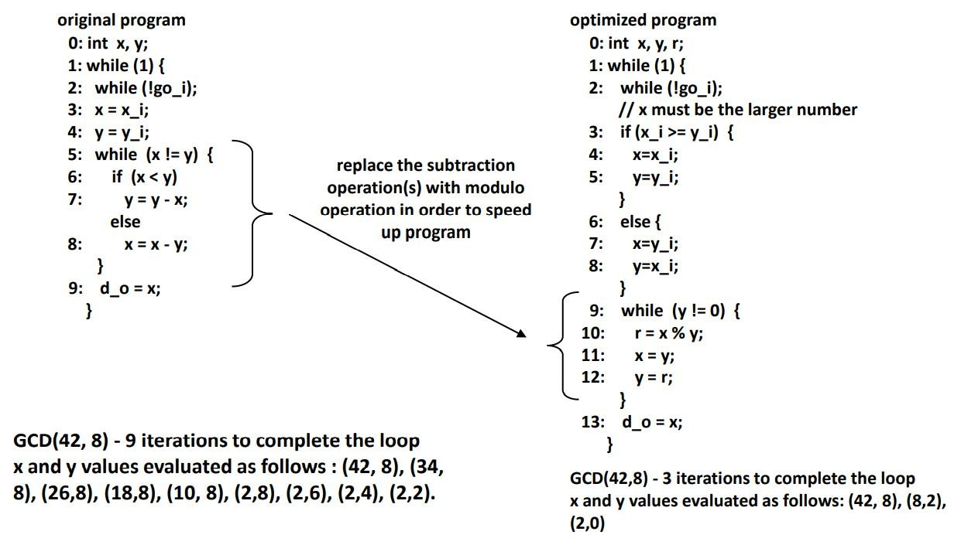
Optimizing the original program

Slide 52
ii. Optimizing the FSMD(finite state machine with data)
Each state in an FSMD is assigned with operations from the desired program; this process is called Scheduling
Areas of possible improvements
Merge states
States with independent operations can be merged
Eliminate
States with constants on transitions can be eliminated since transition to be taken will be fixed as defined by constants.
Some states without any operation can also be eliminated
Separate states
States which require complex operations (a*b*c*d) can be broken into smaller states to reduce hardware size

Slide 53
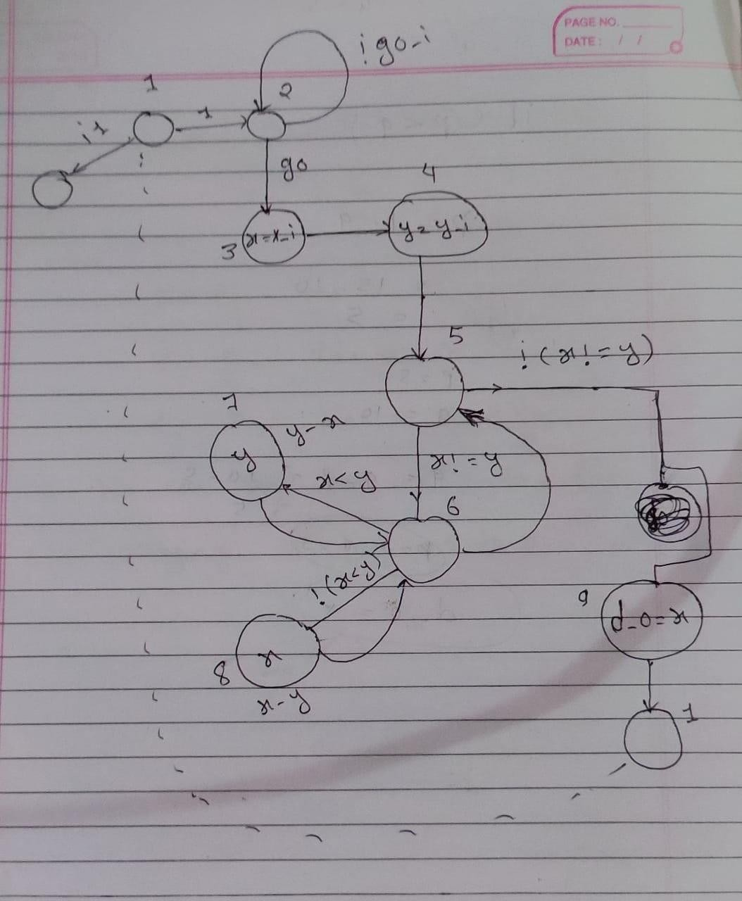
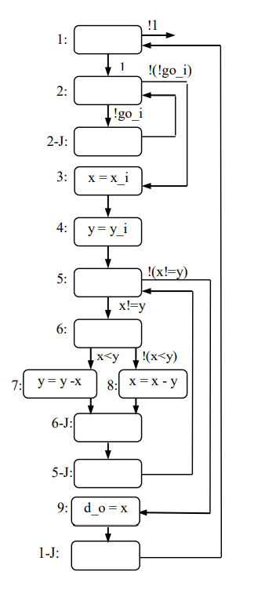
ii. Optimizing the FSMD(finite state machine with data)

Slide 54
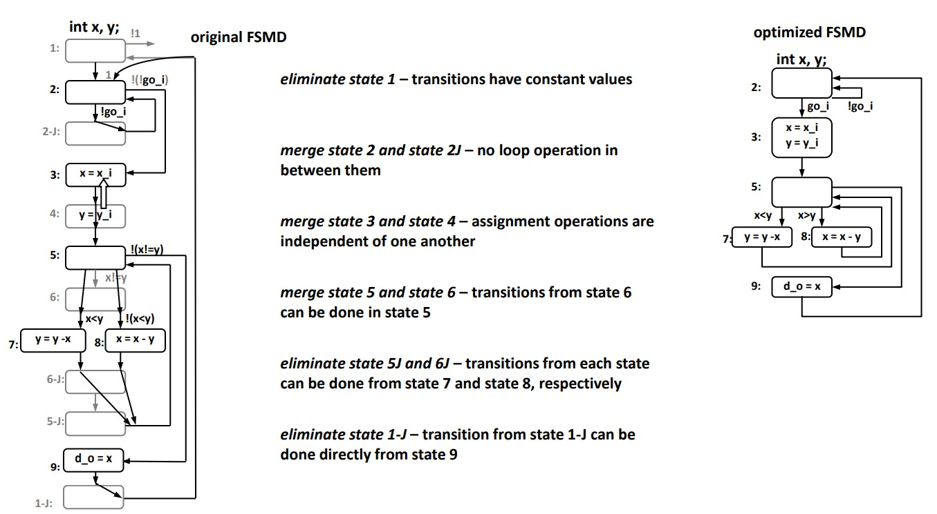
ii. Optimizing the FSMD(finite state machine with data)

Slide 55
iii. Optimizing the data path
Sharing of functional units
One-to-one mapping, as done previously, is not necessary
If same operation occurs in different states, they can share a single functional unit
Multi-functional units
ALUs support a variety of operations, it can be shared among operations occurring in different states

Slide 56
Optimizing the controller(finite state machine)
State encoding
Task of assigning a unique bit pattern to each state in an FSM
Size of state register and combinational logic may be different for different encoding
Can be treated as an ordering problem
CAD tools are helpful to search for best encoding
State minimization
Task of merging equivalent states into a single state
State equivalent if for all possible input combinations the two states generate the same outputs and transitions to the next same state
Notes:
Computer-aided design

Slide 57
SOFTWARE DESIGN ISSUES

Slide 58
General-Purpose Processors
The general purpose processor is a programmable digital system which consists of a datapath and a control unit, tightly coupled with memory as shown fig.
Designed for variety of computational tasks
The general purpose basic architecture consists of:
Datapath
Control unit
Memory
Processor
Control unit Datapath
ALU
Controller
Control
/Status
Registers
PC
IR
I/O
Memory
11/10/20
₂₀ 64
Notes:
Computer-aided design

Slide 59
Assignment2:
Q. Write benefits of using GPP over SPP?
Notes:
Computer-aided design

Slide 60
Data path:
The data path consists the circuitry to transfer the data from one place to another and storing the temporary data.
The data path contains the ALU capable of transferring the data from different operation like additions, subtraction, bitwise OR, AND etc.
ALU also generates the status signals often stored in status register.
These status bit conditions are known as flags. The flags may be zero, sign carry overflow etc.
It also contains register and stores the data temporarily during ALU operation. The temporary data includes:
Data read from memory but not yet send to ALU.
Result from ALU operation that is used for next operation or going to write on memory.
Data that must be moved from one memory location to another location
Notes:
Computer-aided design

Slide 61
Data path:
The capacity of processor measured by bit-width of datapath i.e. data carrying capacity.
The n-bit size processor consists:
N bit registers set
N bit internal and external system bus
N bit ALU
The processor size may be 4, 8, 16, 32 or 64 bit.
Notes:
Computer-aided design

Slide 62
Control path:
The control unit consists of circuitry to general control signals to carry out various operations
Its consists of controller (state register and control logic), program counter(PC) and instruction register(IR)
Controller sequences through the states and generate the control signals to read instruction into instruction register, and control the flow of data between ALU, register of datapath and memory
A register called as program counter (PC) that is use to sequence the program i.e. it points the address of next instruction that is going to fetch and execute. Another register called as instruction register (IR) is used to hold the instruction read from memory.
The register called as Address Register (AR) is used to store the memory address during memory read/write operation.
Notes:
Computer-aided design

Slide 63
Control path:
It controls the data flow on datapath and such flow includes:
Inputting the two particular register for ALU operation.
Storing the ALU results in particular register.
Moving the data between memory and register.
An m bit sized address memory consists the address space of 2^m and controller goes through the following operation to execute an instructions.
Fetching the instruction from memory.
Decode the instruction.
Fetch the operand from memory
Perform the operation on memory.
Store the result.
Notes:
Computer-aided design

Slide 64
Memory:
Registers are used as the short term storage whereas memory is used as the mid-term and long –term storage. Memory be classified as:
Program Memory
Data memory
The program memory is used to store the sequence of instruction called as program which is use to achieve a given functionality whereas data memory use to store the data information and represents the values of input, output, and transformed by program.
We can store the data and program together or separately. The memory architecture follow the following two model:
Von Neumann( a.k.a Princeton) Architecture
Harvard Architecture
Notes:
Computer-aided design

Slide 65
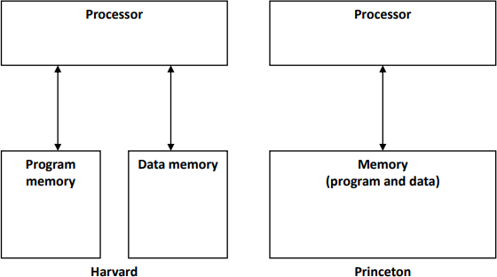
Memory:
The Princeton architecture shares the common memory space to store the data and program and requires one to one connection with hardware.
The Harvard architecture uses the separate memory space to store program as well as data and requires different connection. The microcontroller 8051/52 follow this model.
Notes:
Computer-aided design

Slide 66
GPP Operation
Instruction Execution
Instructions are the set of code that carryout particular functions
The instruction be executed in microprocessor by taking following steps:
Fetch Instruction (FI):
It is a task that reads the instruction from memory pointed by PC and loaded into the instruction register.
Decode Instruction (DI):
In this phase, an instruction be decoded to separate the operand reference as well as operation code to represent the particular operation as ADD, MOV, AND, SUB etc.
Notes:
Computer-aided design

Slide 67
GPP Operation
Instruction Execution
Fetch Operand (FO):
In this stage, the operand be read from the memory represented by the effective address (EA). EA calculation is needed for indirect address.
Execute Instruction (EI):
In this phase, the instruction be executed in accordance with its opcode an operand and generates the result.
Store Result (SR):
The result is stored on the particular destination that may be register or memory.
Notes:
Computer-aided design

Slide 68
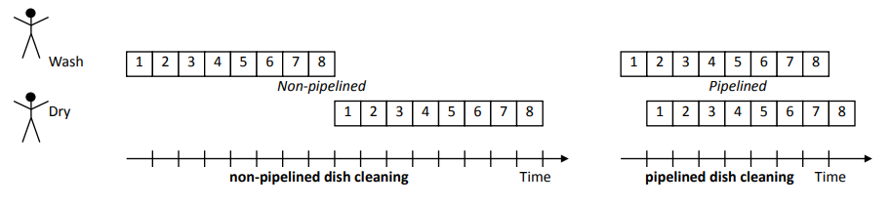
Instruction Execution
Pipelining
The pipeline is a common process to increase the instruction throughput of a microprocessor.
The pipelining is easily understand by taking the example of washing and drying eight dishes as below.
Notes:
Computer-aided design

Slide 69
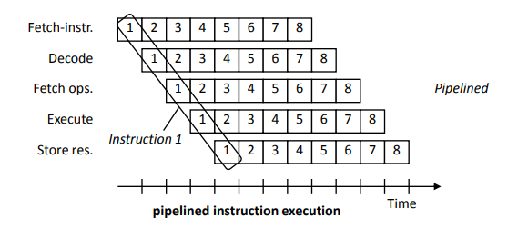
GPP Operation
Pipelining
Notes:
Computer-aided design

Slide 70
GPP Operation
2. Superscalar and Very Long Instruction Word (VLIW) Architecture
A superscalar microprocessor can execute two or more scalar operation in parallel.
Multiple ALU architecture is implemented in super scalar architectures to improve the performance of system
It may require extensive hardware to detect multiple independent instruction that can be executed simultaneously
Instructions in such architectural systems are ordered statically (at compile time) or dynamically (during run time)
VLIW architecture is a type of static super scalar architecture. It contain multiple independent instruction in single word
Several operations are encoded in a single machine instruction. The compiler detect and schedule the instructions
Notes:
Computer-aided design

Slide 71
Programmer’s View
1. Processor Architecture Abstraction
A programmer writes the program instruction carryout the desired functionality on GPP.
For this purpose, programmer doesn’t need to know about the detailed structure of the processor where as he/she need to know how instruction be executed.
There are three levels of programming:
Assembly Level
Structure level
Machine level
Notes:
Computer-aided design

Slide 72
Programmer’s View
Assembly Level:
An assembly language is a low-level programming language for microprocessors and other programmable devices.
It is not just a single language, but rather a group of languages.
An assembly language implements a symbolic representation of the machine code needed to program a given CPU architecture. Assembly language is also known as assembly code.
The assembler is needed to convert the assembly code into machine code.
Notes:
Computer-aided design

Slide 73
Programmer’s View
Structure Level:
Structured programming is a logical programming method that is considered a precursor to object-oriented programming (OOP).
Structured programming facilitates program understanding and modification and has a top-down design approach, where a system is divided into compositional subsystems.
These language are machine independent and need a compiler to convert them into machine code.
Notes:
Computer-aided design

Slide 74
Programmer’s View
Machine Level:
Sometimes referred to as machine code or object code, machine language is a collection of binary digits or bits that the computer reads and interprets.
Machine language is the only language a computer is capable of understanding.
Notes:
Computer-aided design

Slide 75
Programmer’s View
2. Instruction Set
It describes the bit configurations allowed in instruction register (IR)
Each of such configurations forms assembly instruction and a sequence of such instruction form an assembly program.
For e.g. MOV A,#55H
Operand can be data itself, a register, a memory location and I/O post
Five types of instruction for 8051 micro controller
Data transfer Instruction
Arithmetic Instruction
Logical Instruction
Boolean Instruction
Branching Instruction
Opcode | Operand1 | Operand2
Notes:
Computer-aided design

Slide 76
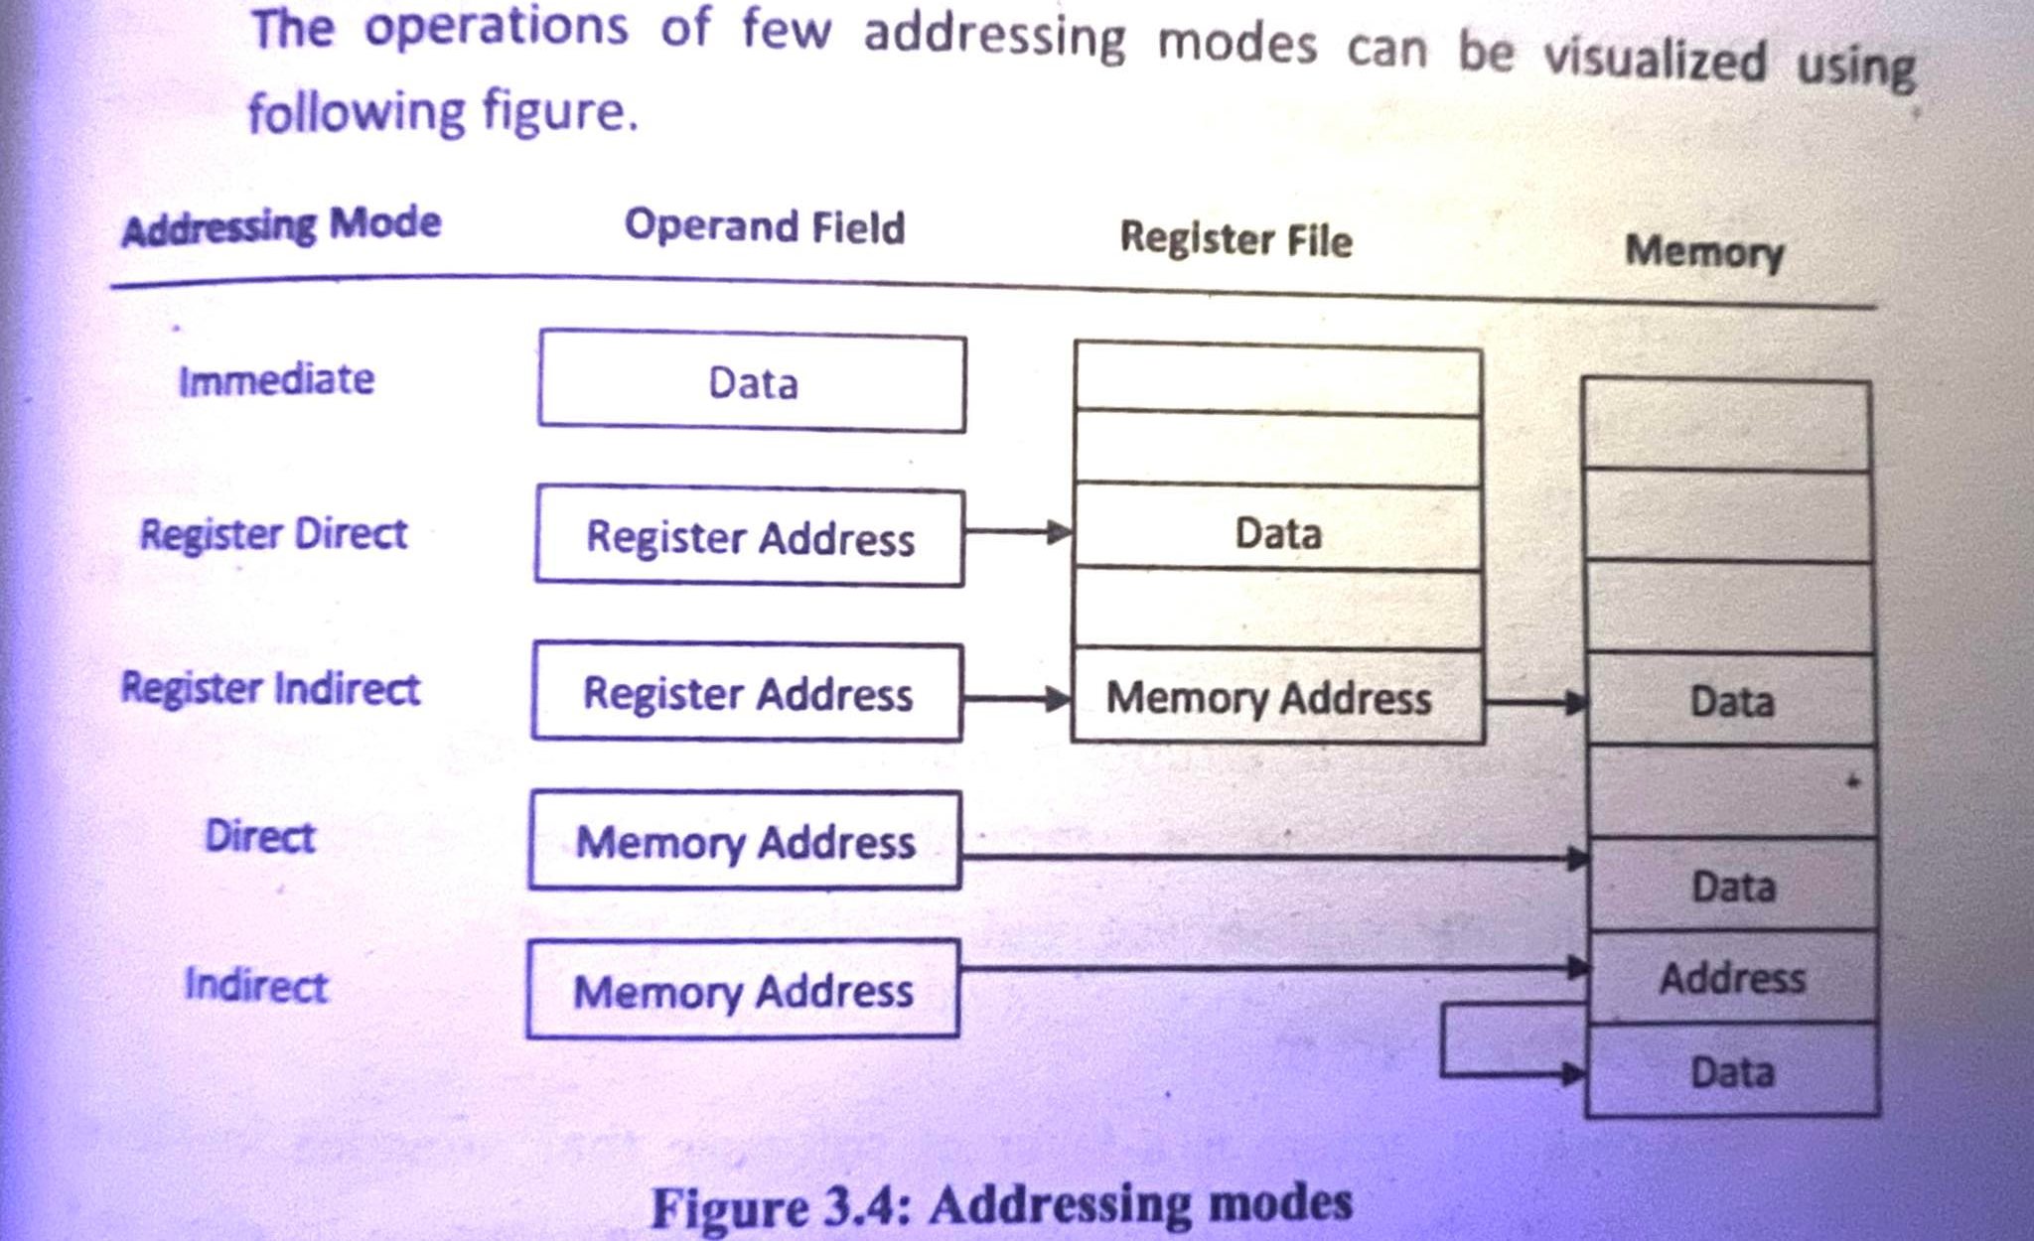
Programmer’s View
3. Addressing Modes
Addressing mode define how machine language instructions identify the operand to each instruction.
Notes:
Computer-aided design

Slide 77
Programmer’s View
4. Program and Data memory space
The programmer in embedded system design must be aware of the size available for program and for data.
Programs must be written within the defined memory space limits
For example, in microcontroller, the on-chip memory for program and for data are fixed.
8085 microcontroller has 128 bytes of on chip RAM, plus a number of Special Function Register(SFR). It can also directly address up to 64k of external memory
Notes:
Computer-aided design

Slide 78
Programmer’s View
5. Available register
programmer of embedded system design must be informed about the number of registers available for general purpose and specific purpose.
For example, multiplication in 8051 microcontroller can be done using accumulator and register B.
Information about accumulator and register B is not required for structured language programmer.
However, various special function registers used for configuring timers, serial communication, and interrupts must be known to every programmer.
Notes:
Computer-aided design

Slide 79
Programmer’s View
6. Input Output Facility
Every processor facilities programmer with input output pins to communicate with external devices.
Programmer with processor must be alert about the number of input output pins and its functions.
In parallel i/o, port can be read and written to using help of special functions register
Also, communications can be done through the system bus in which address and data ports can be activated by certain instructions
Notes:
Computer-aided design

Slide 80
Programmer’s View
7. Interrupt
Interrupt is a facility provided to the user in which the processor serves the device which requires urgent attention.
It causes processor to suspend execution of the current program and starts executing interrupt service routine that does the function required by the device which interrupts the processor.
The programmer should be aware of the types of interrupts supported by the processor and must write interrupt service routine when required.
Notes:
Computer-aided design

Slide 81
Programmer’s View
8. Operating Systems
An operating system is a layer of software that provides low-level services to the application layer.
Few services involve loading and executing of programs, sharing and allocating system resources, and synchronization mechanism.
Another important service is process scheduling in which the high priority process is executed first. Other services include handling hardware interrupts, and provide device drivers.
Notes:
Computer-aided design

Slide 82
Programmer’s View
8. Operating Systems
High level applications invoke operating system using system call.
When a program requires service from operating system, it generates a predefined software interrupt that is served by the operating system.
Values required to the services are typically passed as the parameters in the program.
CPU registers are involved for information exchange among application programs and operating system.
Notes:
Computer-aided design

Slide 83
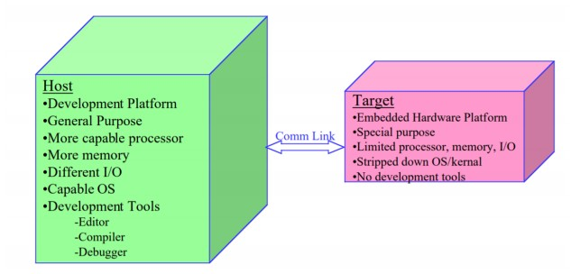
Development Environment
The development environment is comprise of the general software tools they are used to design, testing, validation and verification of embedded system software.

Slide 84
Development Environment
Embedded Systems Programming requires a more complex software build process:
Target hardware platform consists of target hardware (processor, memory, I/O) and Runtime environment (Operating System/Kernel).
Target hardware platform contains only what is needed for final deployment.
Target hardware platform does not contain development tools (editor, compiler, debugger).

Slide 85
Development Environment
Target hardware platform is different from development platform
Development platform, called the Host Computer, is typically a general purpose computer.
Host computer runs compiler, assembler, linker, locator to create a binary image that will run on the Target embedded system.

Slide 86
Tools for Implementation & Verification Phase
1. Tools for Implementation Phase
During the implementation phase, we need tools to convert human developed code into machine readable code
Assembler
Assembler converts assembly instructions to binary machine instructions. It replaces op-code and operand mnemonics by binary equivalent.
It generates an equivalent binary code for a single machine instruction, so it follows one to one mapping principle.

Slide 87
Tools for Implementation & Verification Phase
Compiler
Compiler converts high level programs to machine programs, Each high-level constructs may be translated to several machine instructions. Hence, it may not follow one to one mapping principle.
Cross compilers are those compilers which run on one processor but generate the code for a processor with different architecture.

Slide 88
Tools for Implementation & Verification Phase
Linker
Linker combines object files into a single executable file, or another object file.
It allows creation of a program in separately assembled or compiled files.
It combines machine instructions of user code and instructions from standard library.

Slide 89
Tools for Implementation & Verification Phase
Tools for Verification Phase
During verification phase, we need tools or devices to test whether the code generated for target processor works as per the required functionality
Debugger
They help programmers evaluate and correct their programs.
They run on the development processor and support step wise execution like executing one instruction and then stopping and then proceeding to the next instruction when instructed by user.
They permit execution up to user- specified breakpoints- cause the program to stop execution. Then user can examine values of various memory and register locations.

Slide 90
Tools for Implementation & Verification Phase
Tools for Verification Phase
During verification phase, we need tools or devices to test whether the code generated for target processor works as per the required functionality
Debugger
A source- level debugger enables step-by-step execution in the source program language. A good debugging capability is crucial, due to large and complex program.
They are programs that run on development processor but execute code designed for target processor. So, they always simulate functions of the target processor.
They are also known as ISS (Instruction Set Simulator) or VM(Virtual Machine).

Slide 91
Tools for Implementation & Verification Phase
Tools for Verification Phase
Emulator
Emulator can be a hardware or software that enables one system to behave like another system.
It consists of debugger coupled with a board connected to development processor.
The board consists of target processor or device similar to target processor and support circuitry. It supports debugging of program while it executes on target processor.
The code must be downloaded into emulator hardware in each test, the design cycle is little longer compared to debugger. But it leads to accurate testing as it interacts with the rest of the system components as well.

Slide 92
Tools for Implementation & Verification Phase
Tools for Verification Phase
Device programmer
They downloaded a binary machine program from development processor’s memory into target processor memory.
Once the target is programmed, the entire embedded system can be tested in a realistic way

Slide 93
Design Flow
1. software development process
2. Embedded software process
Notes:
From small book

Slide 94
Application Specific Processor (ASPs)
General purpose processors are designed to execute multiple applications and perform multiple tasks.
General purpose processors can be quite expensive especially for small devices that are designed to perform special tasks. Also general purpose processors might lack high performance that a certain task required. Therefore, application specific processors emerged as a solution for high performance and cost effective processors.
Application specific processors have become a part of our life’s and can be found almost in every device we use on a daily basis. Devices such as TVs, cell phones, and GPSs they all have a form of application specific processors.
An application specific processor combines high performance, low cost, and low power consumption.

Slide 95
Application Specific Processor (ASPs)
Application specific processors can be classified into three major categories:
Digital Signal Processor (DSP): Programmable microprocessor for extensive real-time mathematical computations.
Application Specific Instruction Set Processors (ASIP): Programmable microprocessor where hardware and instruction set are designed together for one special application.
Application Specific Integrated Circuit (ASIC): Algorithm completely implemented in hardware.

Slide 96
Application Specific Systems
Some of the typical approaches of building an application specific system or an embedded system are to use one or more of the following implementation methods: GPP, ASIC or ASIP.
GPP:
Functionality of the system is exclusively build on the software level.
Although the biggest advantage of such system is the flexibility but it is not optimal in term of performance, power consumption, cost, physical space and heat dissipation.

Slide 97
Application Specific Systems
Some of the typical approaches of building an application specific system or an embedded system are to use one or more of the following implementation methods: GPP, ASIC or ASIP.
ASIC:
Compared to GPP, ASIC based systems offer better performance and power consumption but at the cost of flexibility and extensibility.
Although it is difficult to use the ASIC for tasks other than what they were designed for, but it is possible to use GPP to perform the more general less demanding tasks in addition to ASIC in the same system.

Slide 98
Application Specific Systems
Some of the typical approaches of building an application specific system or an embedded system are to use one or more of the following implementation methods: GPP, ASIC or ASIP.
ASIP:
In this approach, an ASIP is basically a compromise between the two extremes;
The Application specific integrated circuit processors ASIC being designed to do mostly a very specific job with high performance but with minimal room for modifications and the general purpose processors which costs a lot more than ASIP but with extreme flexibility at what they do.
Due to this flexibility and low price, ASIP are great to be used in embedded and system-on-a-chip solutions.

Slide 99
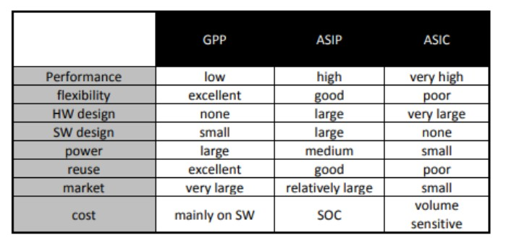
Application Specific Systems

Slide 100
Application-Specific Instruction-Set Processors (ASIPs)
General-purpose processor
Sometimes too general to be effective in demanding application
e.g., video processing – requires huge video buffers and operations on large arrays of data, inefficient on a GPP
But single-purpose processor has high NRE cost, not programmable
ASIPs – targeted to a particular domain
Contain architectural features specific to that domain e.g., embedded control, digital signal processing, video processing, network processing, telecommunications, etc.
Still programmable

Slide 101
A Common ASIP: Microcontroller
For embedded control applications
Microcontroller are specific to applications that perform large amount of data
e.g., VCR, disk drive, digital camera (assuming SPP for image compression), washing machine, microwave oven
It includes several peripheral devices such as timers, analog to digital converters, serial communication devices, and so on.
It generally contains program and data memory on the same IC. Various peripherals along with memory incorporated within the same IC result in compact and low-power implementation.
It provides the programmer direct access to number of pins of the IC. Access to pins enable programmer to interface with other devices such as sensor, actuators, LCDs, and other different devices that may be used in the system.
Some specialized instructions may be available. Such facility improves the performance of the system.

Slide 102
A Common ASIP: Digital Signal Processors (DSP)
These are processors which are specific to applications that process large amounts of data.
The source of large amount of data includes image captured by a camera, voice packet through a network router, audio clip played by an instrument.
It may contain numerous register files, memory blocks, multipliers and other arithmetic units.
Frequently used arithmetic functions are implemented using hardware. It results in faster execution of arithmetic functions compared to software implementation.
Some special digital signal processors allow concurrent execution of functions which boost the performance of the system.
It incorporates many peripherals specific to signal processing. It may include ADC, DAC, PWN, DMA controllers, timers, and counters.

Slide 103
A Common ASIP: Digital Signal Processors (DSP)
Advantages:
DSP provides flexibility: Digital signal processing operations can be changed by changing the program in digital programmable system.
DSP improves performance: It has a better control of accuracy in digital systems compared to analog systems.
DSP supports complex operation: Sophisticated signal processing algorithms can be implemented by DSP method.

Slide 104
Selecting a Microprocessor
The selection basis is the requirement, what the processor needs to do. A processor may be selected on the basis of following parameters.
Speed:
How fast a processor can compute has always been a point of high interest for designers and developers. There is always demand for fast processors.
But good practice is to use a processor required by application.
For eg: A data logging application that records temperature in every 5 minutes might not require a faster processor but a X-ray machine in the emergency ward should have faster one. MIPS (Millions instruction set second) is also used to measure Speed.
2. Instruction Set:
The instruction set defines what a processor can do. Based on task to be performed, an additional set of instruction or totally different instruction set may be required.
In robotic system the processor for driving a motor and analyzing an environment are required to perform different task, instruction set may be different for them.

Slide 105
Selecting a Microprocessor
3. Bit/ Word Length:
It is a size of data the processor can handled, the length of register around processor.
If processor needs to process floating point data, the word length that works for integer type data is no sufficient. A narrower option may works but takes more time.
4. Power Consumption:
Power consumption may not a deciding factor for fixed system but when it comes to a portable handheld device, it becomes a crucial point.
Both the standby and peak power consumption of processor are to be considered.
For example, the low power consumed by mobile phone in standby or sleep and active mode should low.
5. Prior Experience:
While working in a project, a designer would chose a processor with which he has experience.
The availability of development and libraries for the SW for a processor contributes to the performance.

Slide 106
Selecting a Microprocessor
6. Size:
The actual physical size of the processor may impact the design when the trend is going for slim smart devices.
Everything, including processor is required to be small.
7. Cost:
The price of the processor is the ultimate selection factor.
The available project budget may not accommodate expensive processor then designer selects the low cost processor.

